Slide 1
Name:Hüseyin Burak
Surname:Kaşıkçı
Department:Software Engineering
Lesson:Englısh 1 Group 8
Topic: I’d like to meet up with this celebrity

Slide 2
Chris Hemsworth, the Australian actor widely recognized for his iconic portrayal of Thor in the Marvel Cinematic Universe, is a charismatic and talented individual. With his striking looks, towering physique, and magnetic on-screen presence, Hemsworth has become a global sensation. Beyond his superhero role, he has showcased his versatility in various films, from action-packed blockbusters to more nuanced performances. Meeting Chris Hemsworth would undoubtedly be an exciting experience, offering the chance to engage with a down-to-earth celebrity who has left an indelible mark on the entertainment industry.

Slide 3
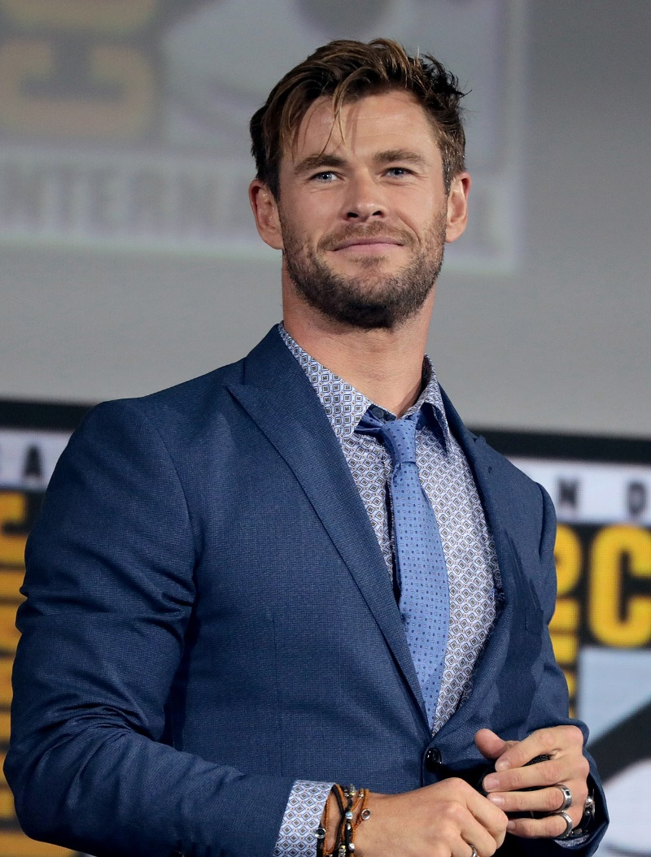
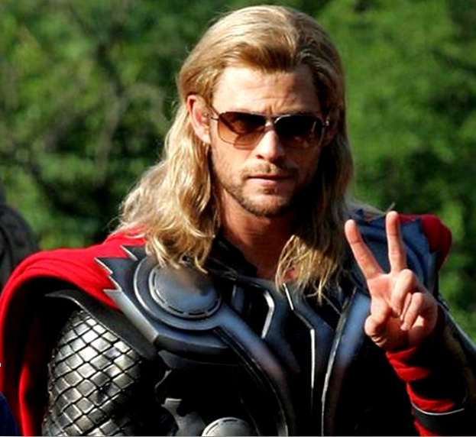
I can meet with whis man anywhere.
I can do shopping,ı can go gym with this man.
He is a THOR

Slide 4
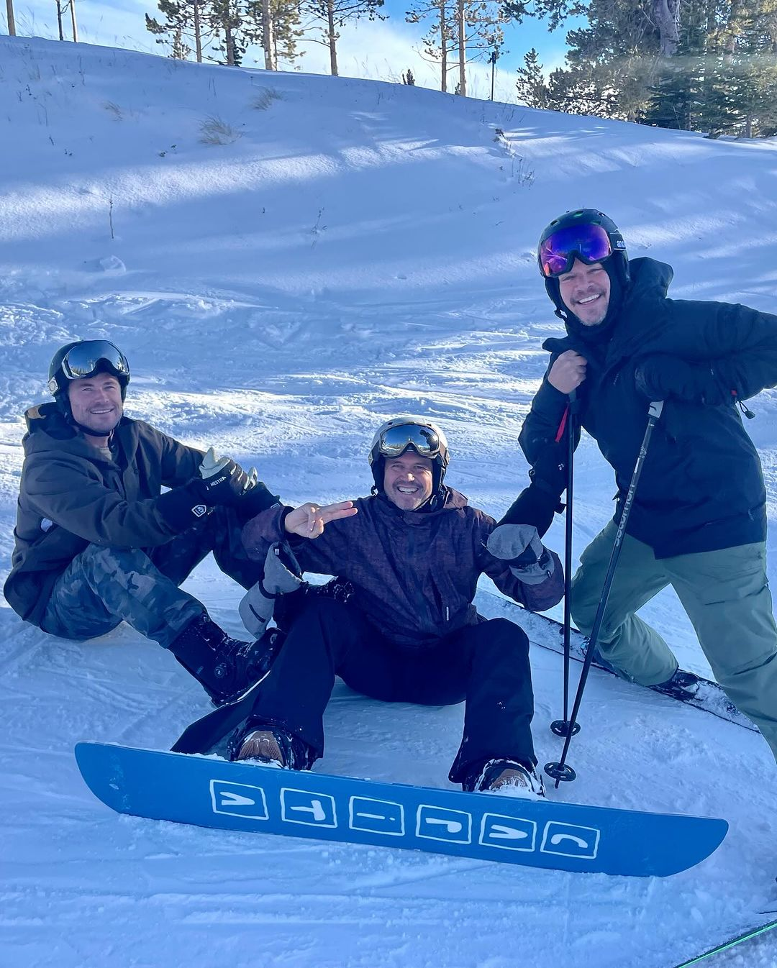
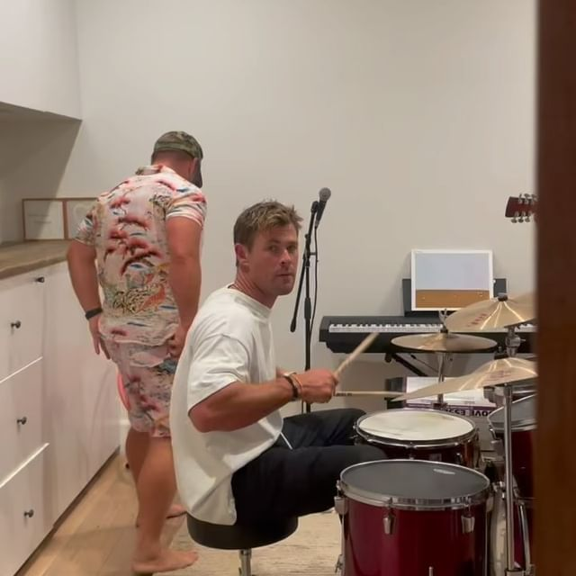
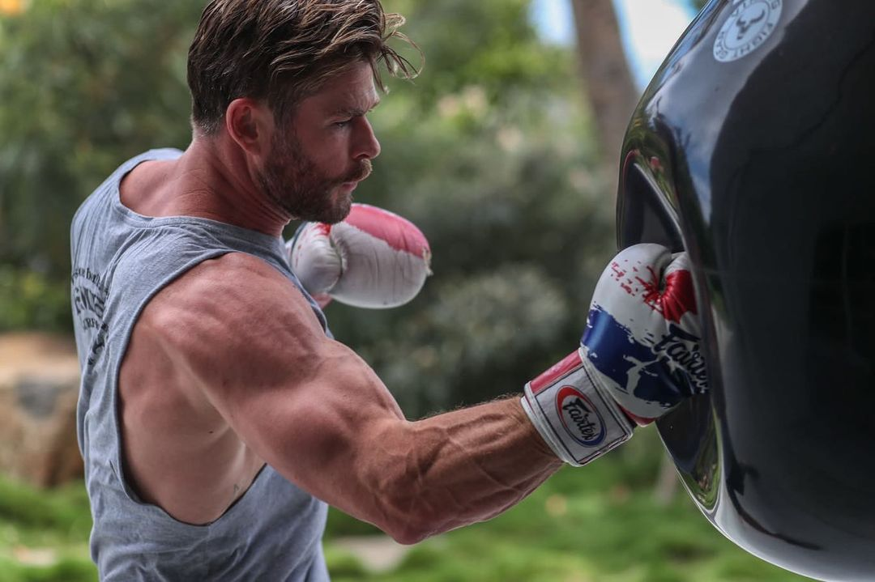
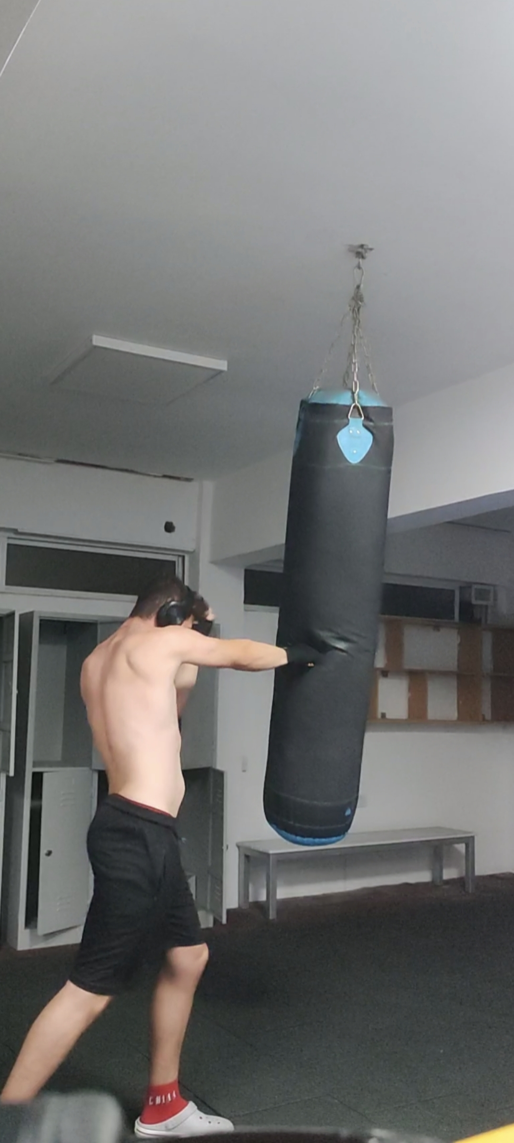
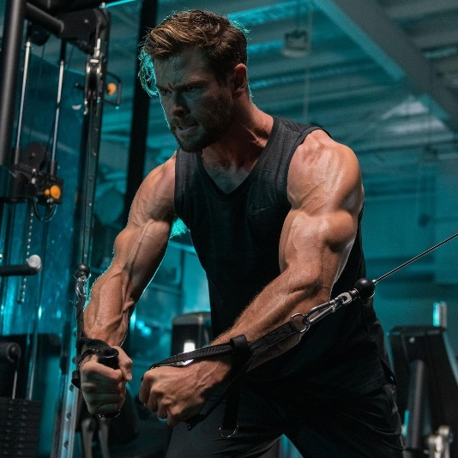
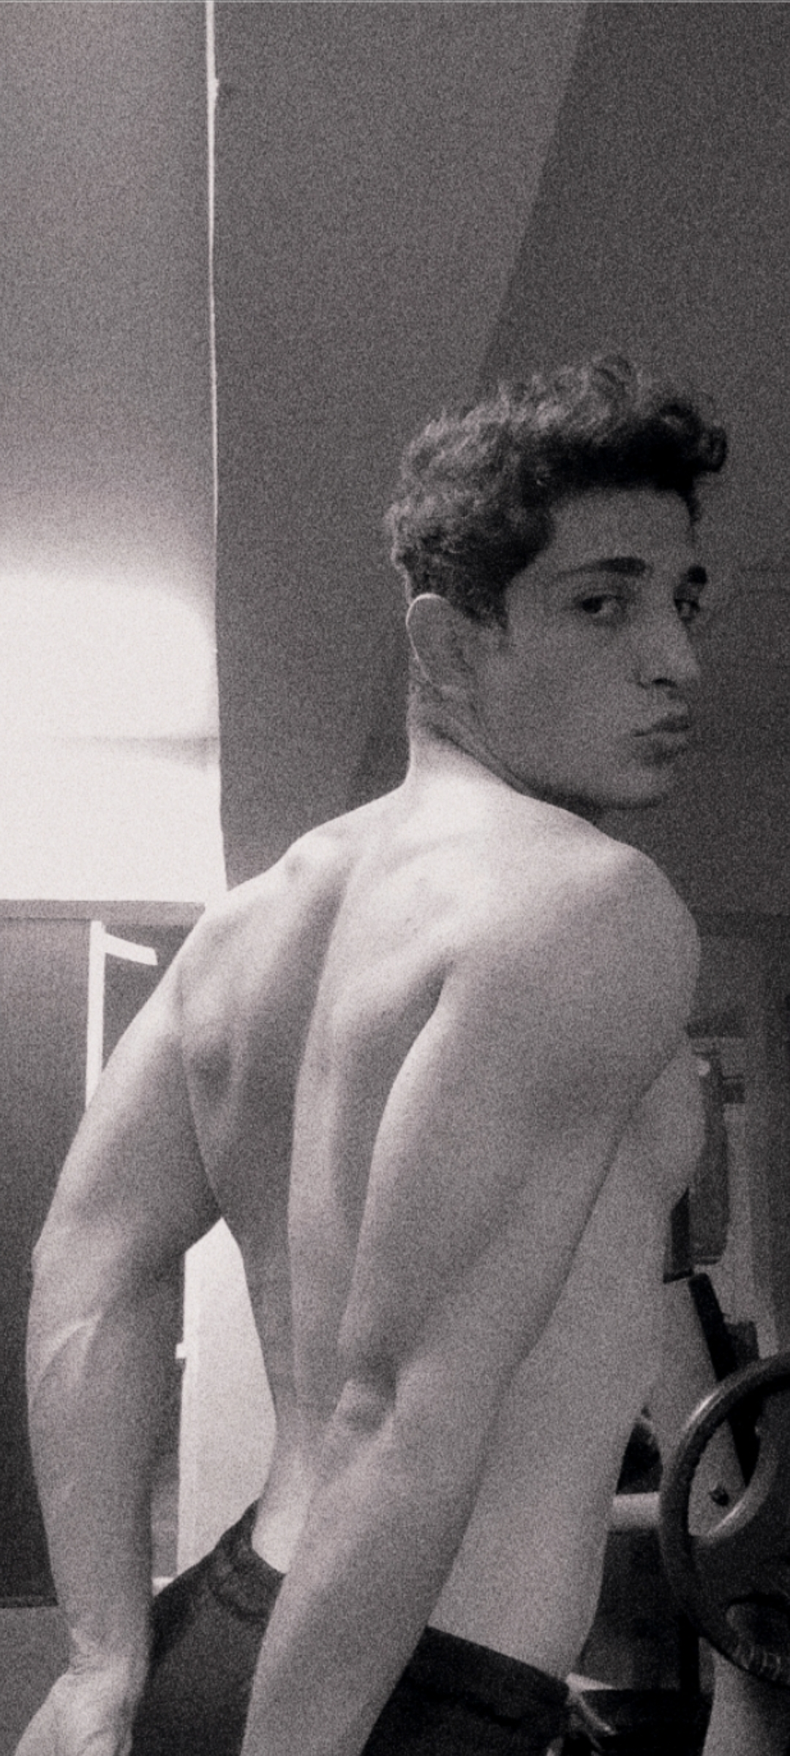
He can do snowboard with me.He like snowboarding with friends.
He can play drum for me.He is a good at.
If we go gym we will be good gym bro’s

Slide 5
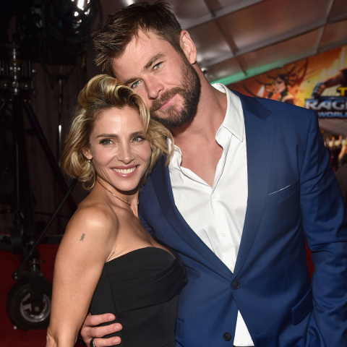
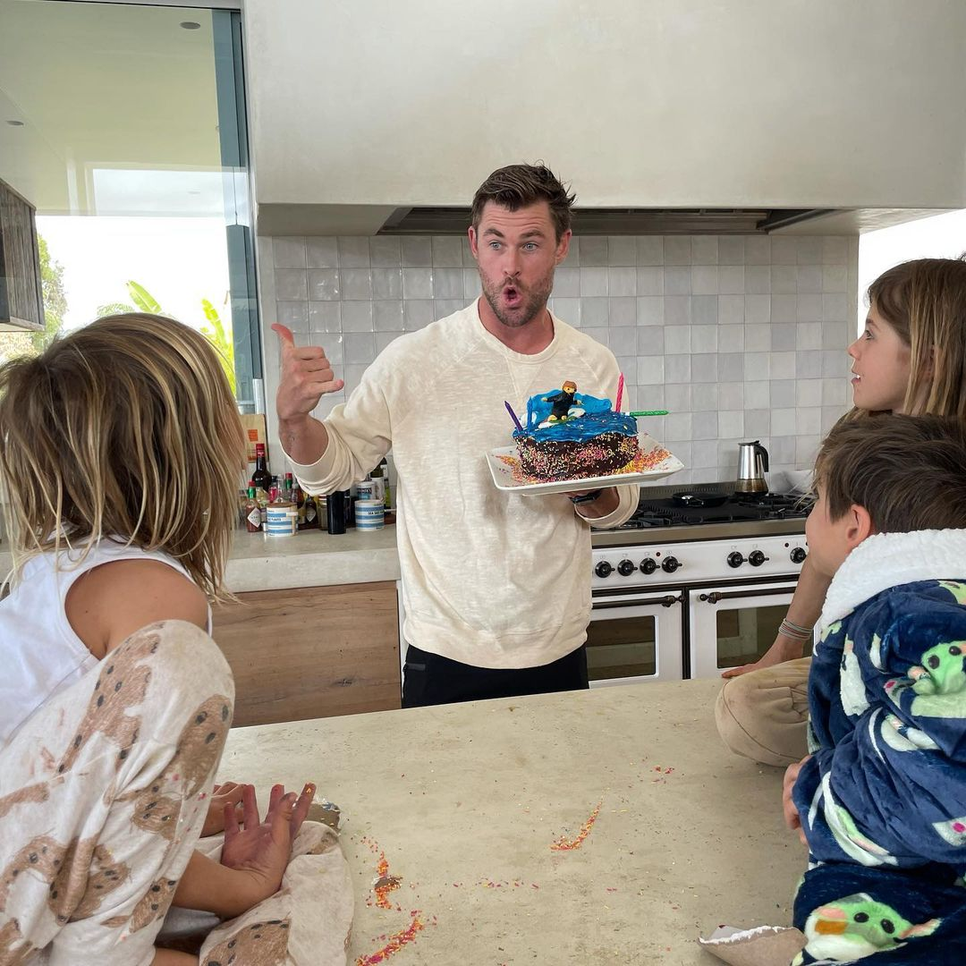
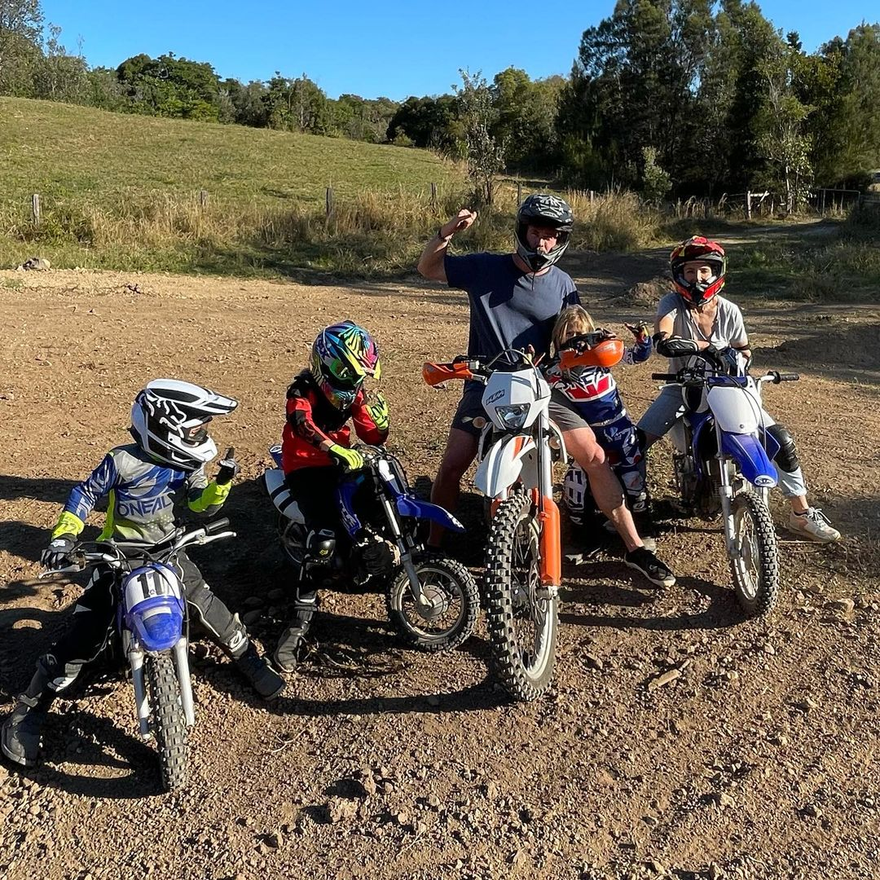
He has a wonderful wife and kids.
He is a good father.This man todally my idol.

Slide 6

This man have a lot of good movies but my favorite is extraction.It was a brilliant action movie.İts about saving one child and he is looking this child like his child.

Slide 7
Thank you.

